Slide 1
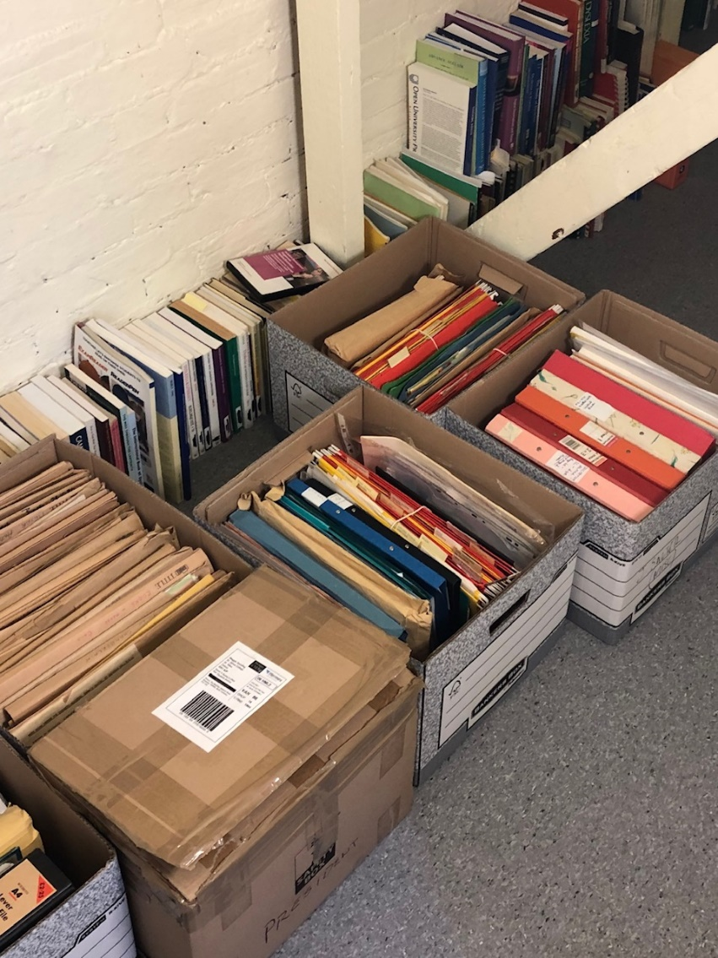

1. The archive: An update I
Archive initially catalogued, planned for relocation to new library building at St John’s College
Materials kindly donated by Chris Augur, Michael Brand, Tim & Elaine Miles, Bangor Dyslexia Unit, BDA, Dyslexia Action, Mike Thomson, Robin and Jennifer Salter, Helen Arkell Centre, Bernadette McLean, Diana Crewdson, European Dyslexia Association, Joyce Hargrave-Wright, Michael Gay, Arts Dyslexia Trust, amongst many others

Slide 2
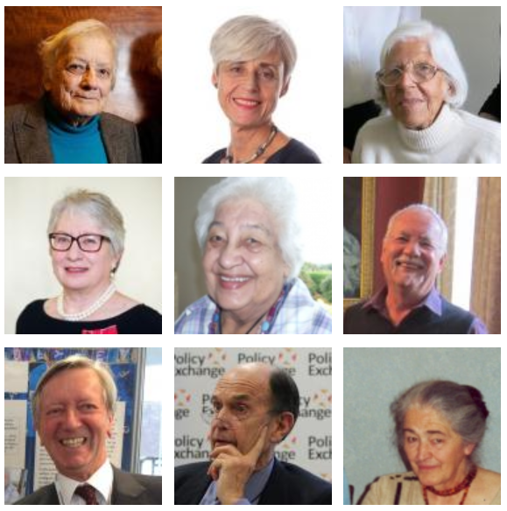
2. The archive: An update II
Archive contains interviews with: Helen Arkell, Chris Augur, David Blunkett, Lynette Bradley, Steve Chinn, Ann Cooke, Joe Elliott, Sue Flohr, John Friel, Uta Frith, Daphne Hamilton-Fairley, Susan Hampshire, Jocelyn Hardwick, Joyce Hargrave-Wright, Charles Hulme, Barbara Maughan, Bernadette McLean, Elaine Miles, Sandhya Naidoo, Qona Rankin, Margaret Rooms, Jim Rose, Mike Rutter, Jennifer & Robin Salter, Kate Saunders, Maggie Snowling, John Stein, Mike Thomson, Patience Thomson, Mary Warnock, Bill Watkins, Steve Williams, & Bill Yule

Slide 3
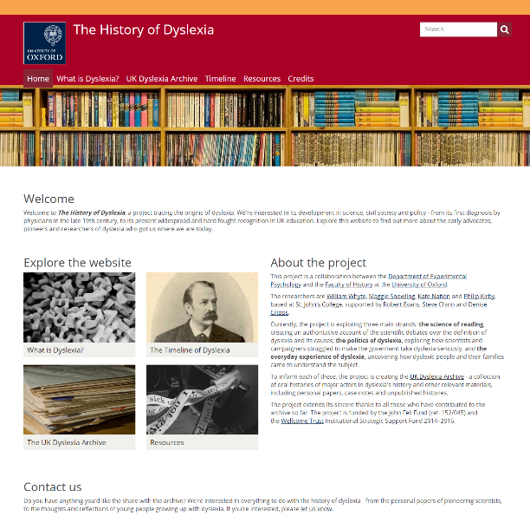
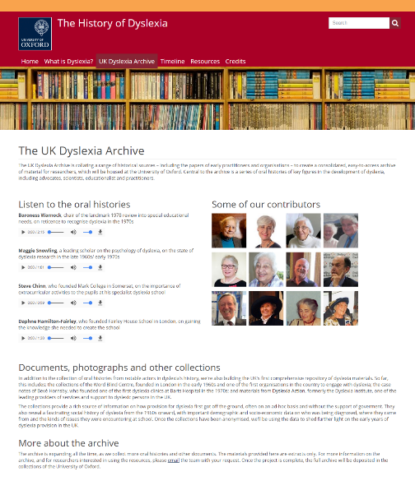
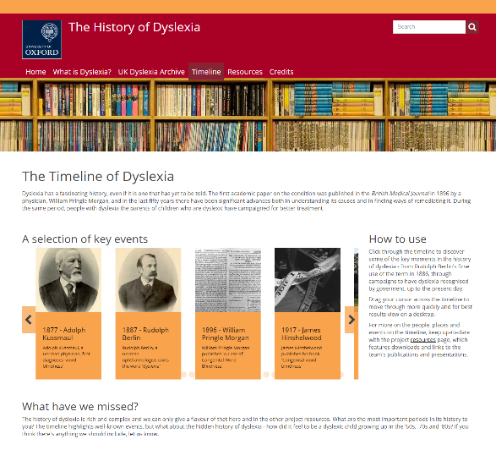
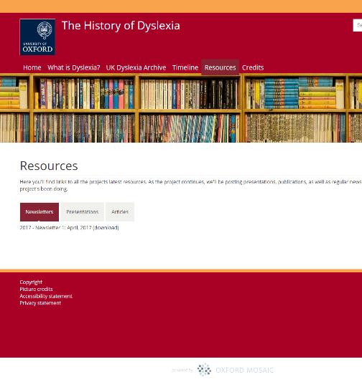
3. History of dyslexia website
https://dyslexiahistory.web.ox.ac.uk/
Hosts a small selection of audio clips from the archive, a history of dyslexia timeline, a brief history of dyslexia, and a resources page
Links to the project’s latest publications and presentations, previous media coverage
Launched in July, 2017
Approx. 1,000 visits per month
Hosted by: Oxford Mosaic

Slide 4
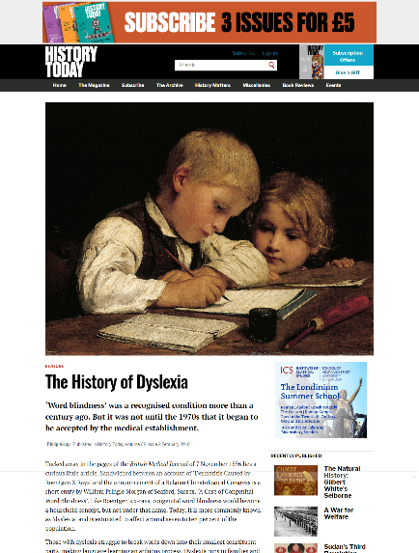
4. Dyslexia archive publications (2018-)
Journal articles:
Oral History
Social History of Medicine
Disability & Society
Magazine articles:
History Today
The Psychologist
Research briefs:
British Dyslexia Association
Other publications:
The Conversation
Book reviews
In-house magazines
Future publications:
American Historical Review
Oxford Dictionary of National Biography
Oxford Review of Education (special issue)

Slide 5
5. Gender and the dyslexia myth (Oral History)
Historicizing current criticisms of dyslexia, responding to arguments from popular (Rod Liddle, Peter Hitchens) and academic spheres (The Dyslexia Debate, 2014)
Three common associations in these criticisms, which the paper shows were a necessary part of the movement:
  Dyslexia and ‘worried mothers’
  Dyslexia and the ‘middle-classes’
  Dyslexia and dubious science
Draws on 20 oral histories from the archive

Slide 6
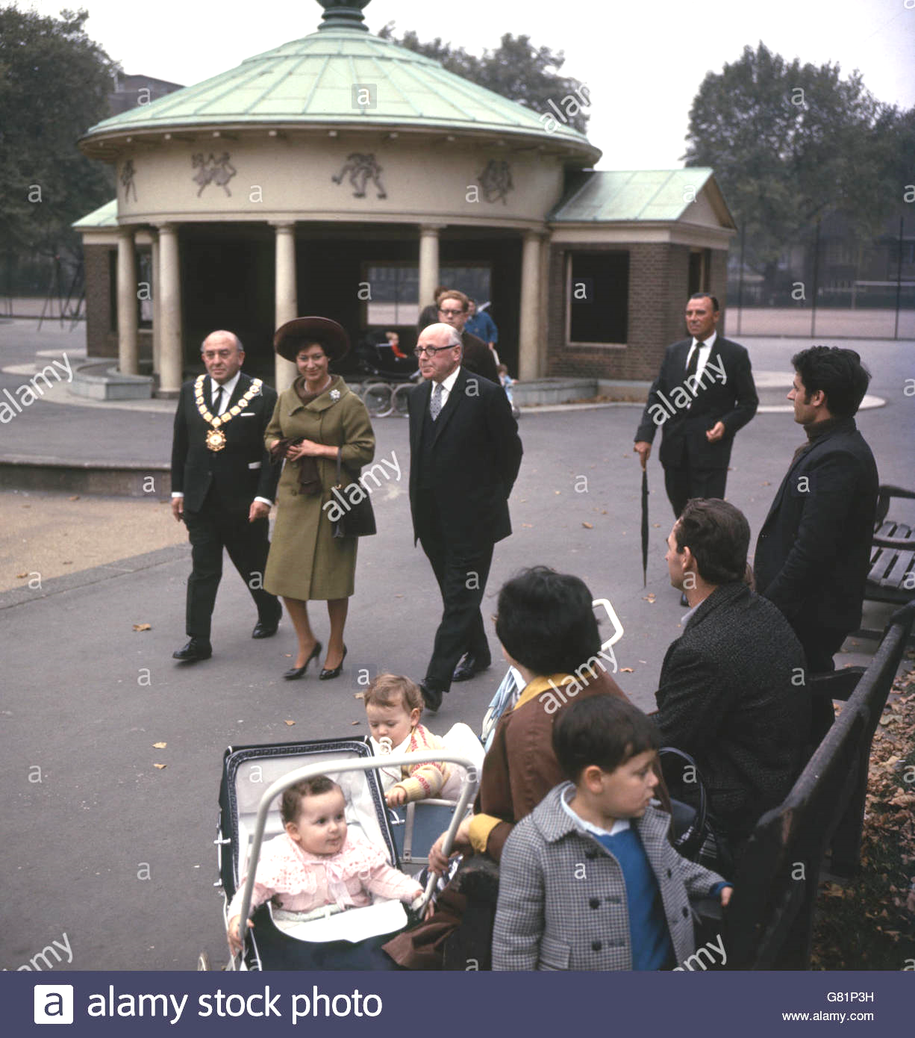
6. Campaign for recognition (Social Hist. of Med.)
An account of the campaign for political recognition of dyslexia in the UK (1962-97), in order to record its achievements
Three periods considered:
  Word Blind Centre to founding of the BDA, Dyslexia Institute and other organisations (1962-72)
  The work of these organisations, researchers and others in embedding dyslexia into society (1972-78)
  The pathway to formal government recognition in the 1980s/90s, and (greater) state support (1978-97)
Draws on 10 oral histories from the archive, the files of the Word Blind Centre, and other materials

Slide 7
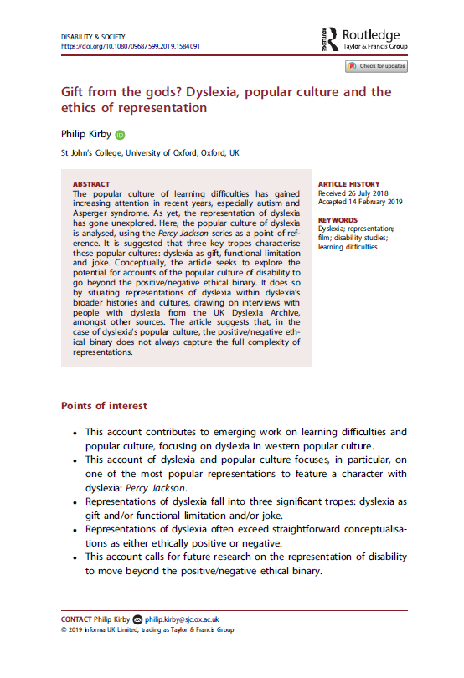

7. Dyslexia in popular culture (Disability & Soc.)
An account of representations of dyslexia in popular culture, focusing on the book and film series, Percy Jackson
Surveyed references to dyslexia in the online script database, QuoDB. Three main themes:
  Dyslexia as gift
  Dyslexia as functional limitation
  Dyslexia as joke
Aim: to better understand how certain knowledges of dyslexia are communicated
Draws on 5 oral histories from the archive

Slide 8
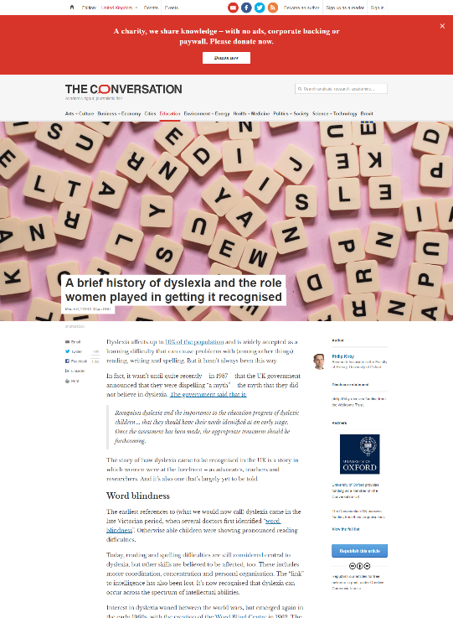
8. Public outreach/ media
The project has broadened general awareness of the research through media-focussed work
News media:
  On International Women’s Day (2018), an article for the Conversation on the role of women in the dyslexia movement (republished in the Independent)
Magazines:
  For History Today and the Psychologist, overviews of dyslexia’s history, with findings from the archive
Research briefs:
  For BDA, a research brief historicizing dyslexia myth, responding to 2019 conference criticising dyslexia

Slide 9
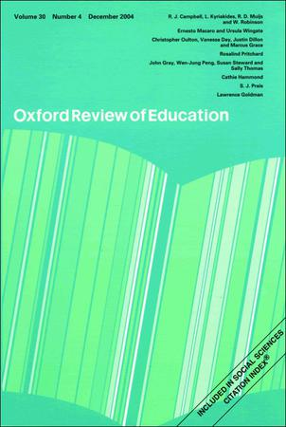
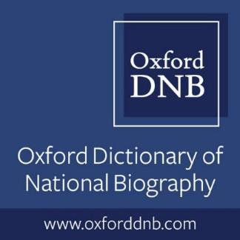
9. Future publications
Oxford Review of Education (special issue)
  Due for publication in 2020, this will collect several articles on dyslexia’s history, written by the project team and external contributors
  It will include accounts of dyslexia’s Victorian origins, and latest science, as well further analysis of the dyslexia myth
Oxford Dictionary of National Biography
  Preparing entries for 10 notable figures in dyslexia’s history, for special collection
American Historical Review
  Dr Kieran Fitzpatrick, former researcher on the project, preparing article on work of Samuel Orton in US

